Slide 1
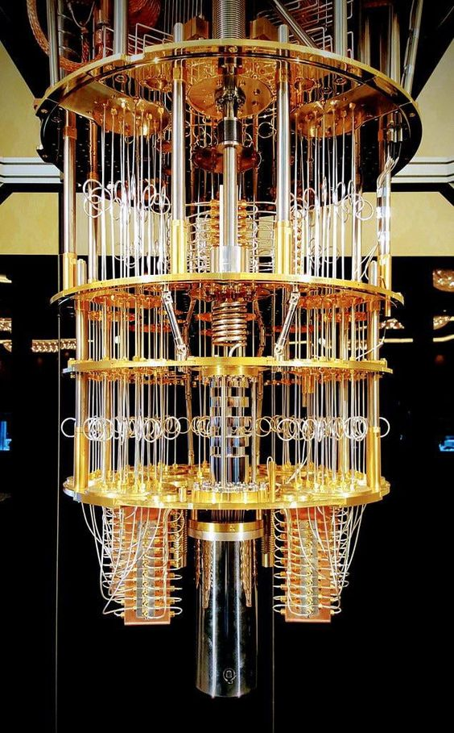
FUTURE & SCOPE OF QUANTUM COMPUTING CRYPTOGRAPHY
BY-SHRINKHAL
UNDER THE GUIDANCE OF DR MANOJ KUMAR

Slide 2
WHAT WILL WE LEARN HERE THROUGHT THIS PRESENTATION:
WHAT IS QUANTUM CRYPTOGRAPHY?
SCIENTIFIC PRINCIPLES UNDERLYING QUANTUM CRYPTOGRAPHY
PRESENT CRYPTOGRAPHY AND ITS TYPES.
POST QUANTUM CRYPTOGRAPHY AND ITS TYPES.
ALSO THE MERITS AND DEMERITS OF EACH WILL BE COVERED HERE

Slide 3
WHAT IS QUANTUM CRYPTOGRAPHY?
“THE SCIENCE OF PERFORMING QUANTUM MECHANICAL PROPERTIES TO PERFORM CRYPTOGRAPHIC TASKS.”
QUANTUM CRYPTOGRAPHY
QUANTUM
ALGORITHMS
CRYPTOGRAPHY

Slide 4
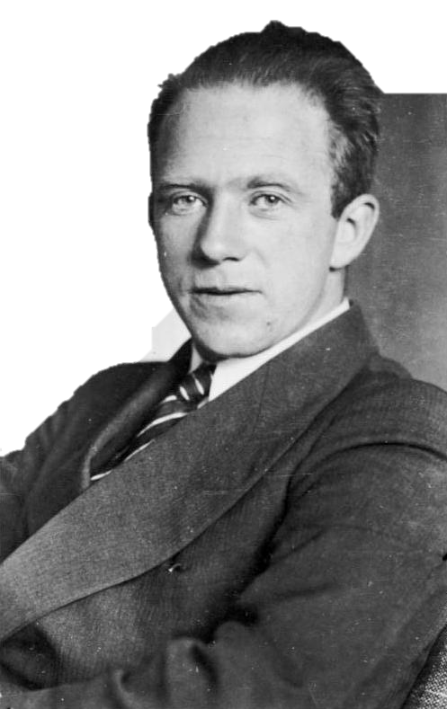
HEISENBERG UNCERTAINITY PRINCIPLE
In 1927,German researcher W. Heisenberg said , it will not be possible to accurately determine both the position and velocity at the same time.
PHOTON POLARISATION PRINCIPLE
As per this principle it creates a quantum state which cannot be recognized and distorts other information if anyone tries to measure the bit.

Slide 5
PRESENT CRYPTOGRAPHY
At present times we have namely:
Symmetric cryptography
Asymmetric cryptography

Slide 6





SYMMETRIC CRYPTOGRAPHY
HERE SENDER AND RECEIVE HAVE THE SAME CRYPTOGRAPHIC ALGORITHM AND SECRET KEY.
PLAIN
TEXT
ENCRYPTED CIPHER TEXT
DECRYPTED
PLAIN TEXT
MERIT
It is essentially unbreakable.
It requires only one key hence much faster to execute.
ENCRYPTION KEY(K1) ECRYPTION KEY(K1)
DEMERIT
Key distribution
Key management

Slide 7
ASYMMETRIC CRYPTOGRAPHY
HERE SENDER AND RECEIVE HAVE THE different CRYPTOGRAPHIC ALGORITHM AND SECRET KEY.
PLAIN
TEXT
ENCRYPTED CIPHER TEXT
DECRYPTED
PLAIN TEXT
MERIT
Key distribution problem is eliminated
Allows non-repudiation so sender can deny sending a message
DEMERIT
ENCRYPTION KEY(K1) DECRYPTION KEY(K2)
It is a slow process
Its public keys are not authenticated.

Slide 8
HASH FUNCTION
UNIQUE IDENTIFIER FOR EACH GIVEN PIECE OF CONTEXT.
TAKES PLAIN TEXT OF UNIQUE SIZE TO CONVERT INTO CIPHER TEXT OF ANY SIZE.
MERIT
Help in authentication ,server stores hash value of the password ensuring no sniffing.
Even Rabin Carp algorithm uses hashing to findany pattern in string.
DEMERIT
Inefficient due to high number of collisions.
Doesn’t allow Null values.

Slide 9
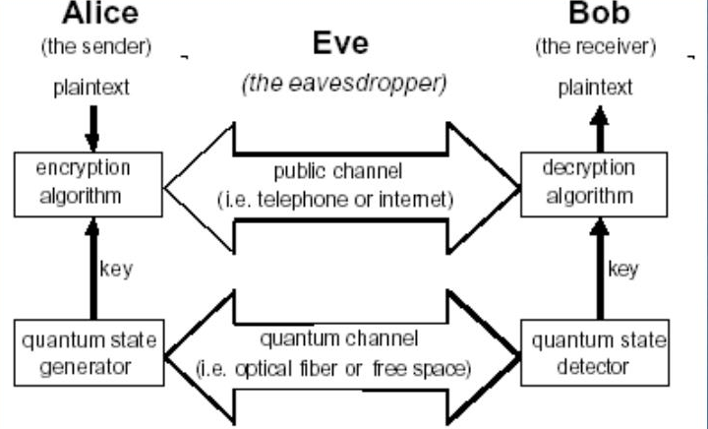
POST QUANTUM CRYPTOGRAPHY
A] QUANTUM KEY DISTRIBUTION
Use quantum mechanic’s system to generate and distribute cryptographic keying material.
MERIT
Allow detection of eavesdropping as error comparatively more when eavesdropper on quantum channel
Utilization of supreme key permitted by additional encryption using traditional algorithm thus data security increased.
DEMERIT
Complete solution of distribution key not provided by network values in system it supports.
The data transfer rate decreases immediately with rise of channel length.

Slide 10
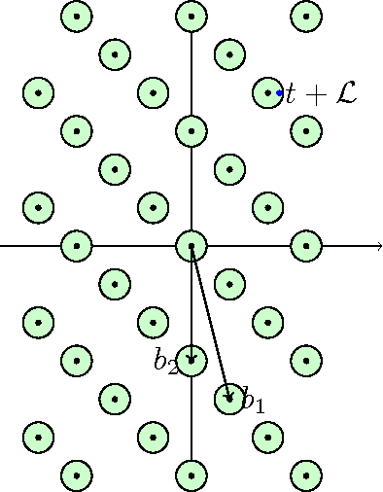
There are other implications as – Multivariate based cryptography , Hash Based Cryptography & Code Based Cryptography
Most researched mathematical implications are-
i] LATTICE BASED CRYPTOGRAPHY
UNLIKE OTHERS LATTICE BASED CRYPTOGRAPHY IS RESISTANT TO BOTH CLASSICAL AND QUANTUM CRYPTOGRAPHY.
MERIT
Offers improved security as lattice more difficult to break.
Its faster than other cryptographic algorithms-streaming and online gaming.
DEMERIT
Difficult to give estimation of security on existing software and hardware.
Their implementation on these platforms vulnerable to pry attack.

